Slide 1
Week 2 Notes
PHY495: Hoop Never Misses

Slide 2
What I’ve Done
Introduced backboard for 2D plots (wrote code for 3D but couldn’t test it because of issue importing 3d plotting), added a try-except condition for if the ball does/doesn’t hit the backboard
Tried to look for energy lost with plywood (couldn’t find it)
Extended plot and differential equations to 3D (z is vertically up, y is distance to hoop, x is position on width of hoop)
Added a function in both 2d-shot.py and 3d-shot.py to check whether the basketball made it in the basket (only assumes bounce off the backboard – no bouncing off the rim later)

Slide 3
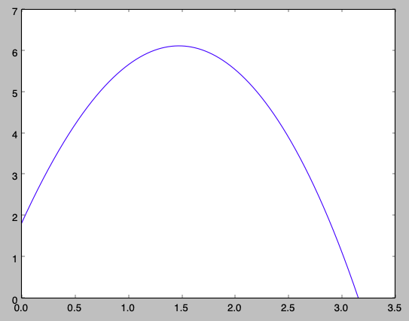
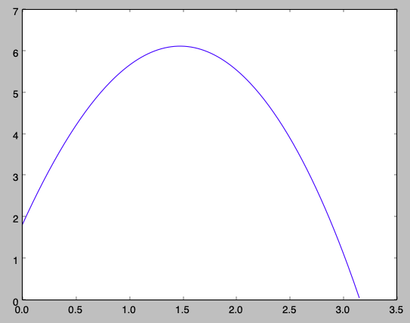
Start_height = 1.8; v0 = 9.8; angle = 80
odeint
RK4

Slide 4
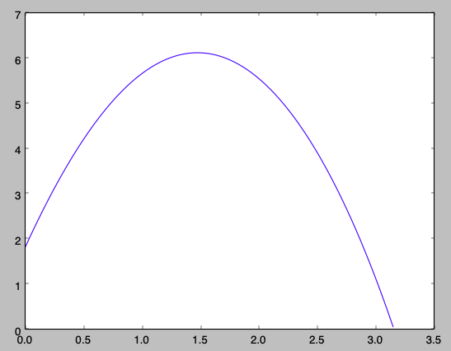
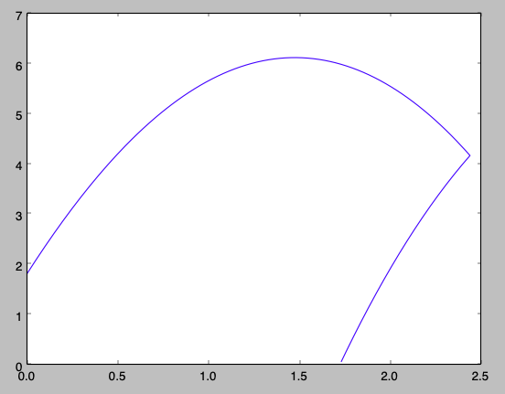
Start_height = 1.8; v0 = 9.8; angle = 80; distance_backboard = 2.5
without backboard
with backboard

Slide 5
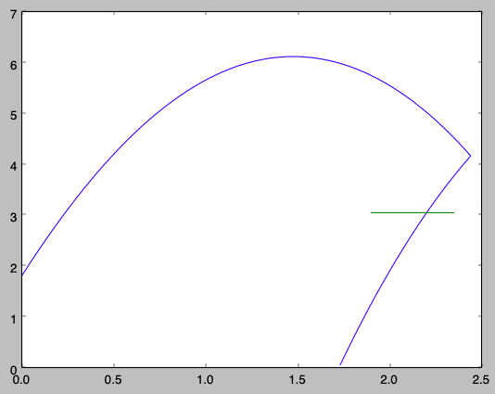
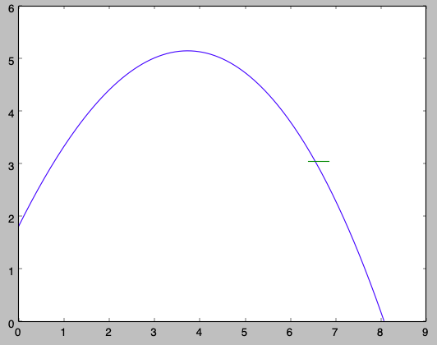
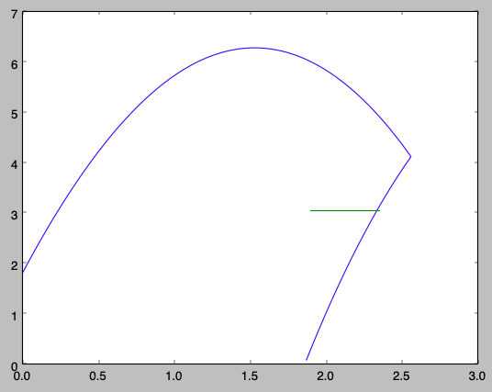
What Worked
*even though it goes through the “hoop”, it goes through so close to the edge that only the centre of the ball would go through the hoop, not the whole diameter
In_basket function worked:
TRUE
TRUE
FALSE
Start_height = 1.8; v0 = 9.8; angle = 80; distance_backboard = 2.5
Start_height = 1.8; v0 = 9.8; angle = 60; distance_backboard = 7
Start_height = 1.8; v0 = 10; angle = 80; distance_backboard = 2.5

Slide 6
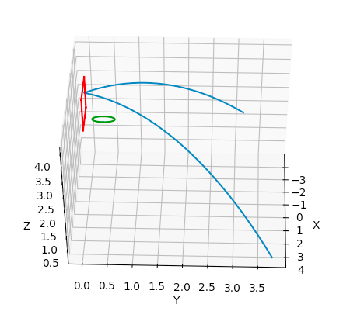
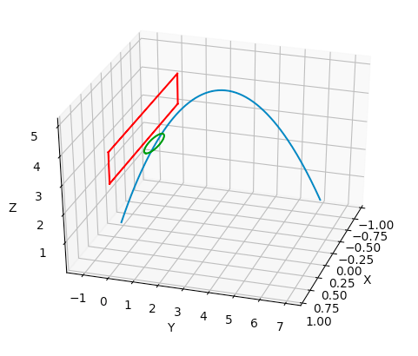
3D shot with backboard – I also included a hoop to show where the basket is
Middle shot from the last slide, goes in!

Slide 7
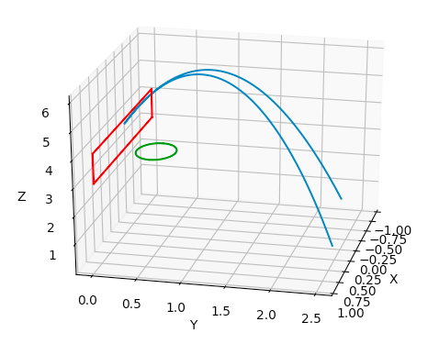
What Didn’t Work
This shot should’ve gone in according to the first plot two slides ago (start_height = 1.8; v0 = 9.8; angle = 80; start_y = 2.5; start_x = 0), but it didn’t in 3D

Slide 8
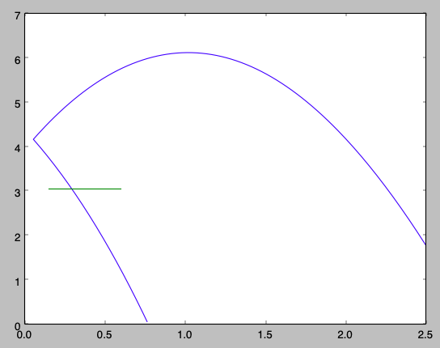
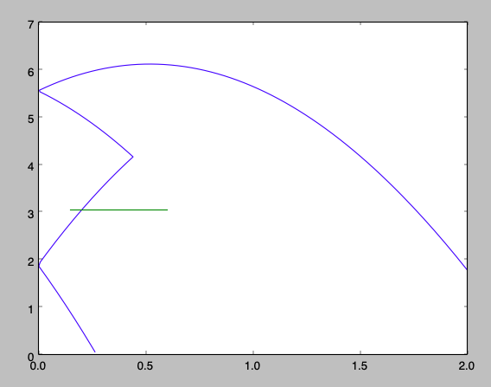
What Didn’t Work
Sometimes when I limited the 3D plotting to 2D it would work but other times it wouldn’t
It worked here, for a shot that we know goes in:
Start_height = 1.8; v0 = 9.8; angle = 80; start_y = 2.5
But something weird happened here (same initial conditions as the previous shot but a starting y distance of 2 instead of 2.5

Slide 9
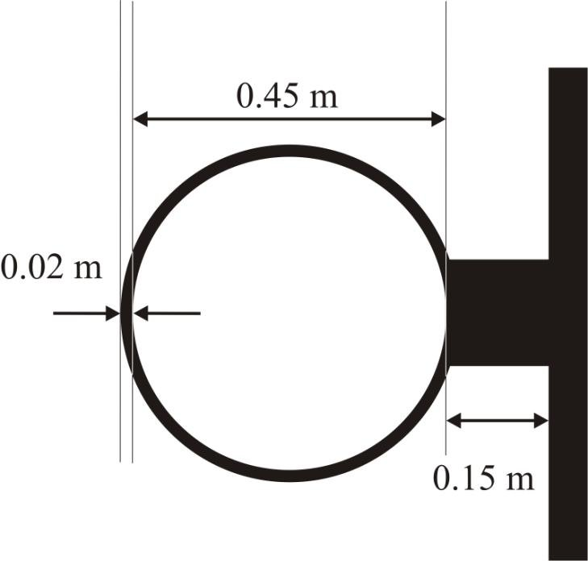
Where am I Stuck
How should I handle the rim of the hoop? It’s possible for the basketball to hit the rim and not bounce into the basket. Can we assume if some point along the diameter of the basketball hits the rim it will/won’t bounce towards the basket? If it hits the rim and bounces in, should I assume an elastic collision?
"the rebound elasticity of any basket ring support system shall be within a 35 percent to 50 percent energy-absorption range of total impact energy, and within a 5 percent differential between baskets on the same court.” → but are we using the same material for the rim?

Slide 10
What Next?
Get 3D code fully working
Figure out energy lost for backboard and rim
Start thinking about how I’ll run the Monte Carlo simulation

Slide 11
Sources
HOOP DIMENSIONS - https://www.researchgate.net/figure/Basketball-hoop-inner-diameter-045-m-hoop-piping-diameter-002-m-and-distance-015_fig3_274248017
RIM ENERGY ABSORPTION - https://www.borgmanathletics.com/page/fair-court-rim-testing

